Slide 1
Project on ONLINE VOTING SYSTEM (e-vote)
SUBMITTED TO:- SUBMITTED BY:-
MR. DHEERAJ SINGH RACHIT KUMAR(2000270140039)
RACHIT TOMAR(2000270140040)
TEJASVI CHAUHAN(2000270140058)

Slide 2
INTRODUCTION TO THE PROJECT
Develop a Website on which online voting will be held such
as college election and class coordinator election etc.
This site will helps people to cast their vote through online using their mobile, tablets, and personal computer and out the elections result In very less time than offline voting.
* e-vote

Slide 3
features of the project
• LOGIN/REGISTER: User can register using their Aadhar Card or voter id and mobile no and can login using the username and password.
ACCOUNT: user will be able to cast their vote after creating the account.
EASY ACCESS: user can access the website using their mobile , tablets and personal computer.
RESULT: site will out the elections result in the specific time and the user can see the result on the portal.
AUTHENTICATION/VALIDATION: authentication with the Aadhar Card for secure login, one user can cast vote one time only.

Slide 4
various modules are
USER
ADMIN
SELCTION OF VOTING EVENT
CONTACT US

Slide 5
Tools WHICH ARE USED TO DEVELOP THE WEBSITE
VS CODE: as a source code editor made by microsoft
XAMPP: is open-source cross-platform web server consisting Apache HTTP Server, SQL for database.
MySQL: as a database
APACHE: is a web server and responsible for accepting directory (HTTP) requests from Internet users and sending them their desired information in the form of files and Web pages

Slide 6
LANGUAGES used to develop website
HTML, HTML5
CSS
JAVASCRIPT
PHP
MySQL

Slide 7
FRONT END

Slide 8
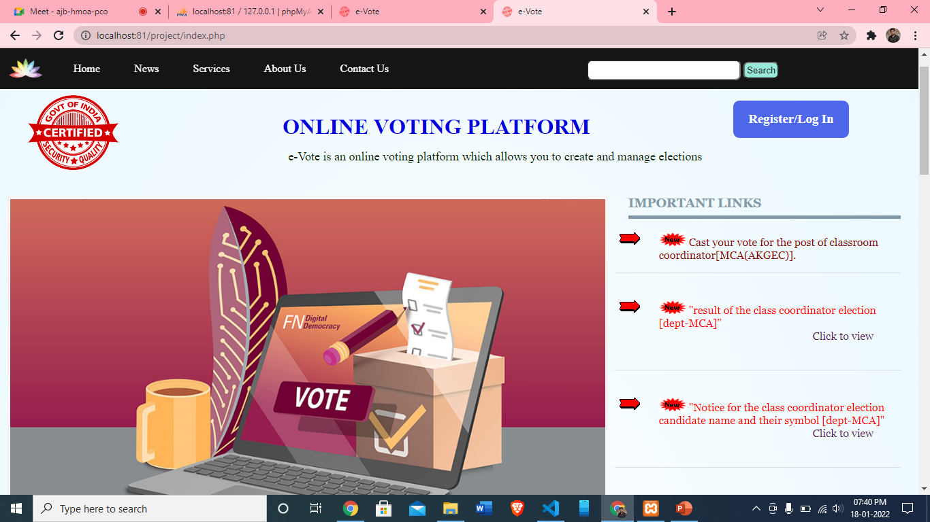
HOME PAGE

Slide 9
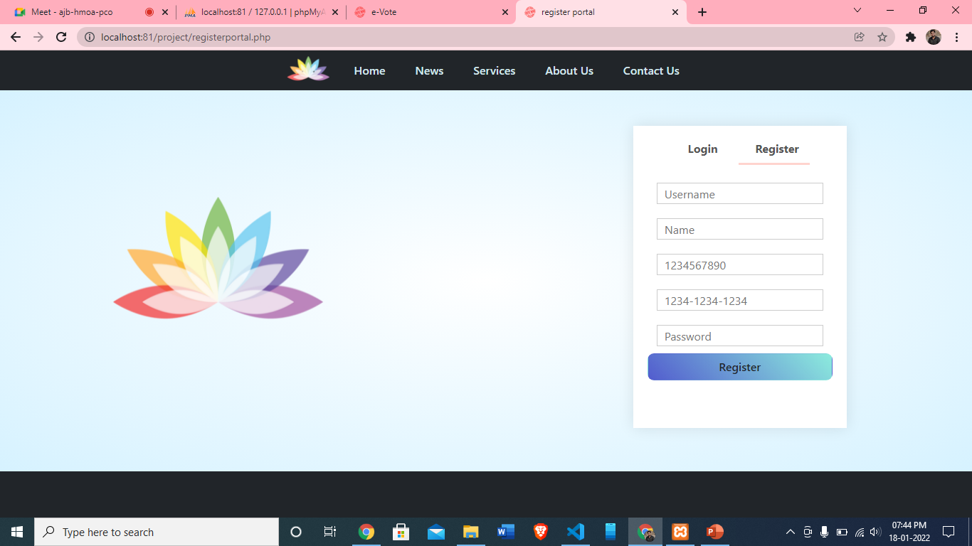
REGISTER

Slide 10
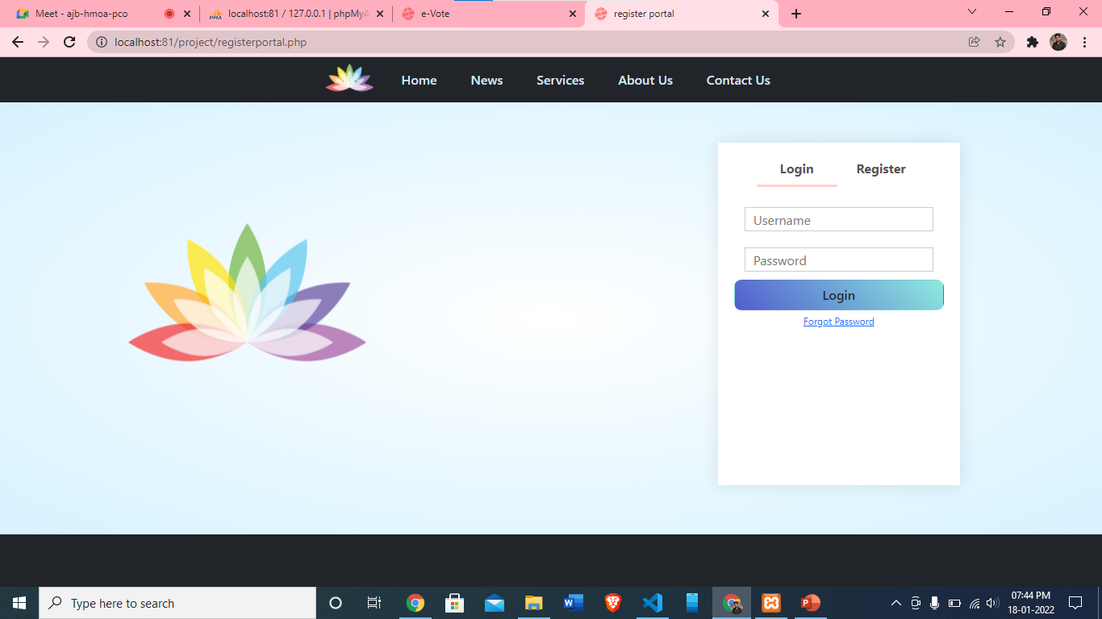
LOGIN

Slide 11
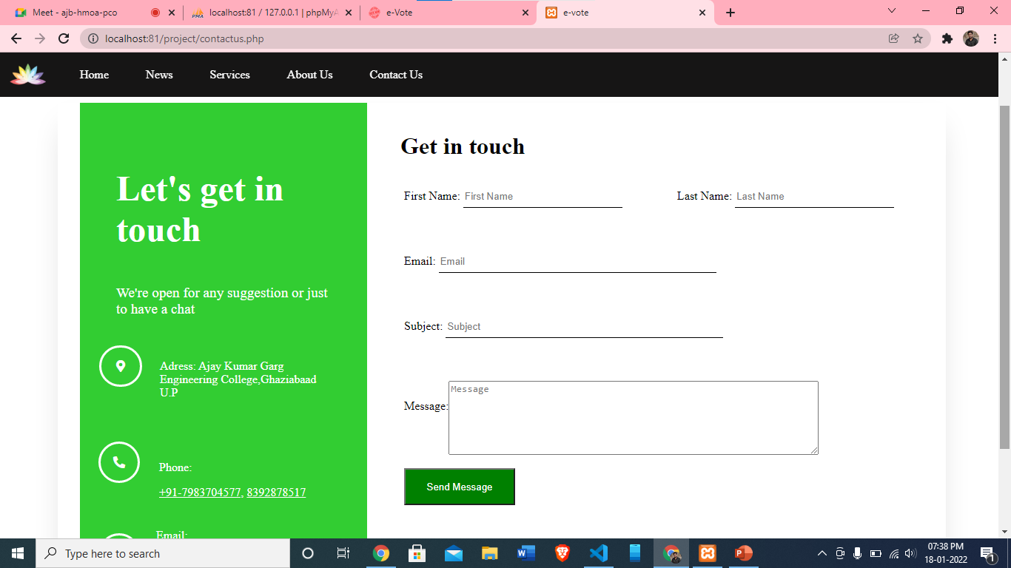
CONTACT US

Slide 12
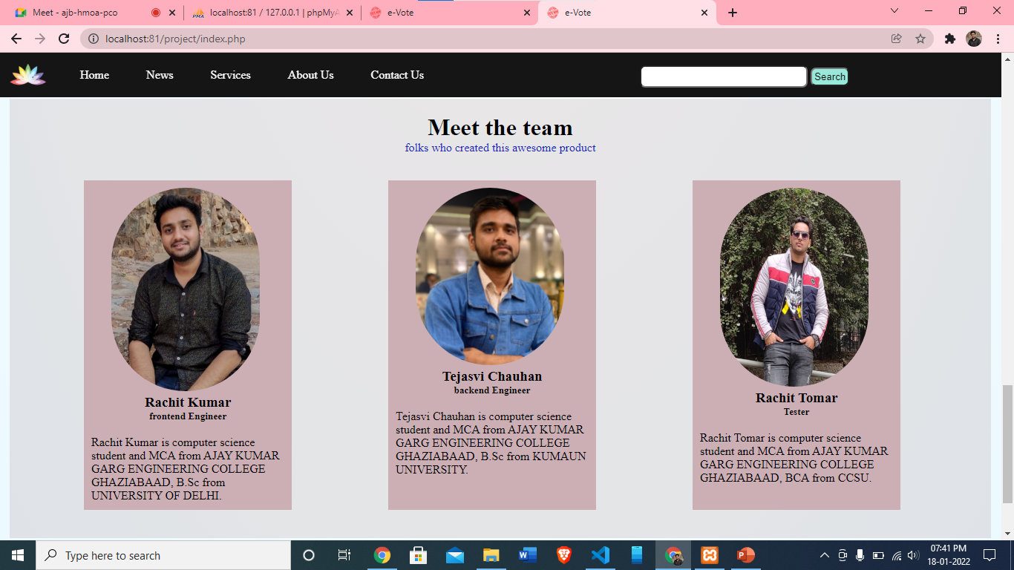
ABOUT US

Slide 13
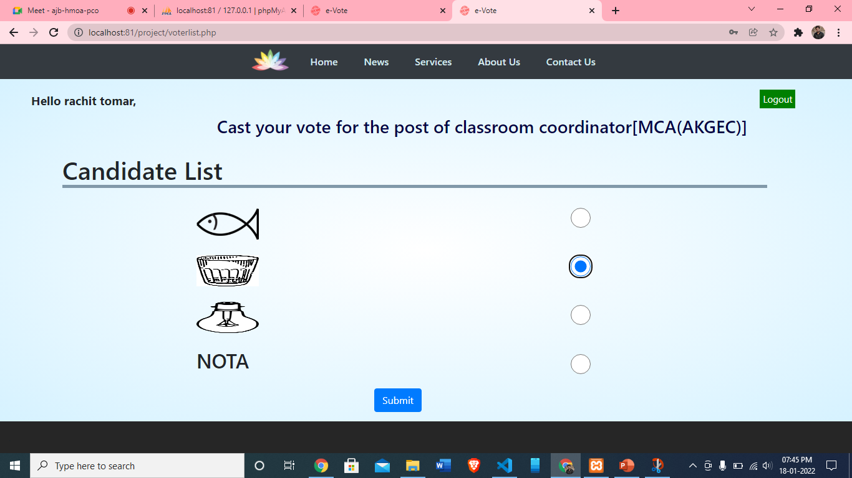
USER PANEL

Slide 14
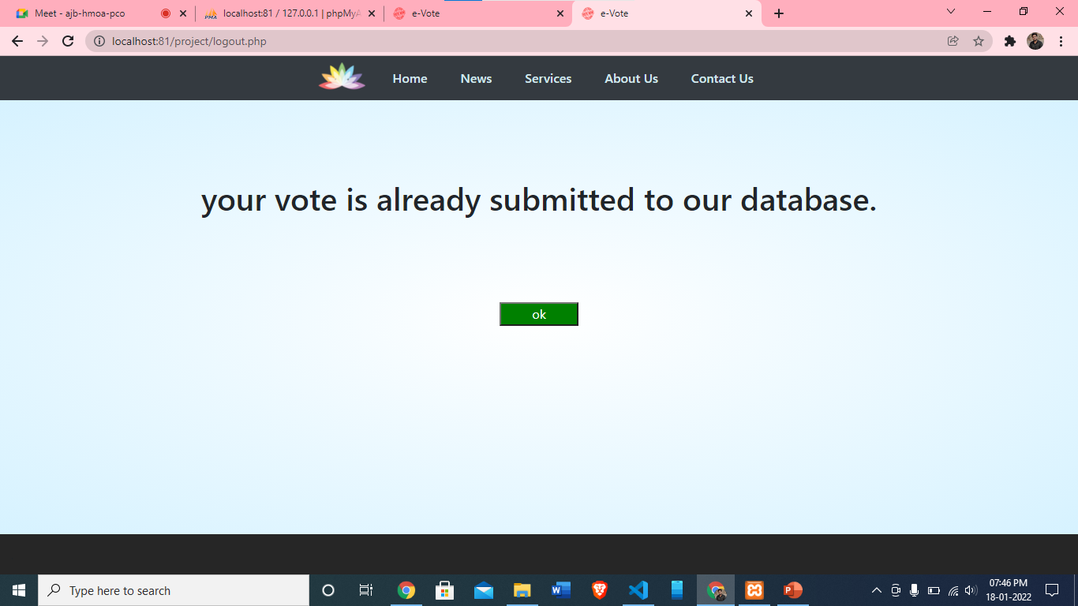
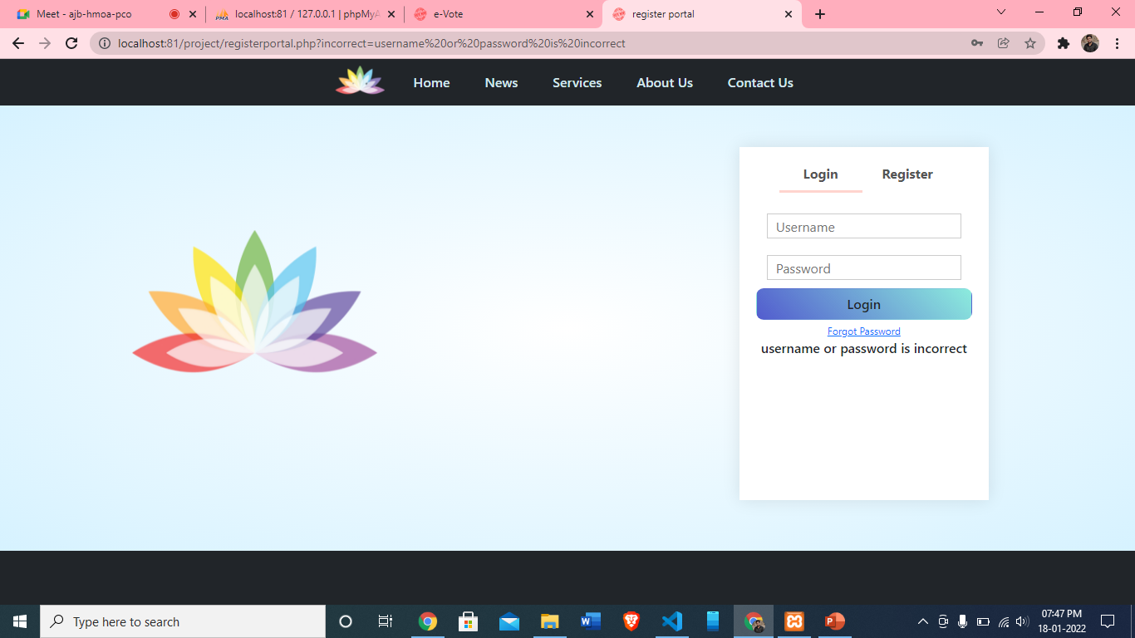
AUTHENTICATION/VALIDATION

Slide 15
BACK END

Slide 16
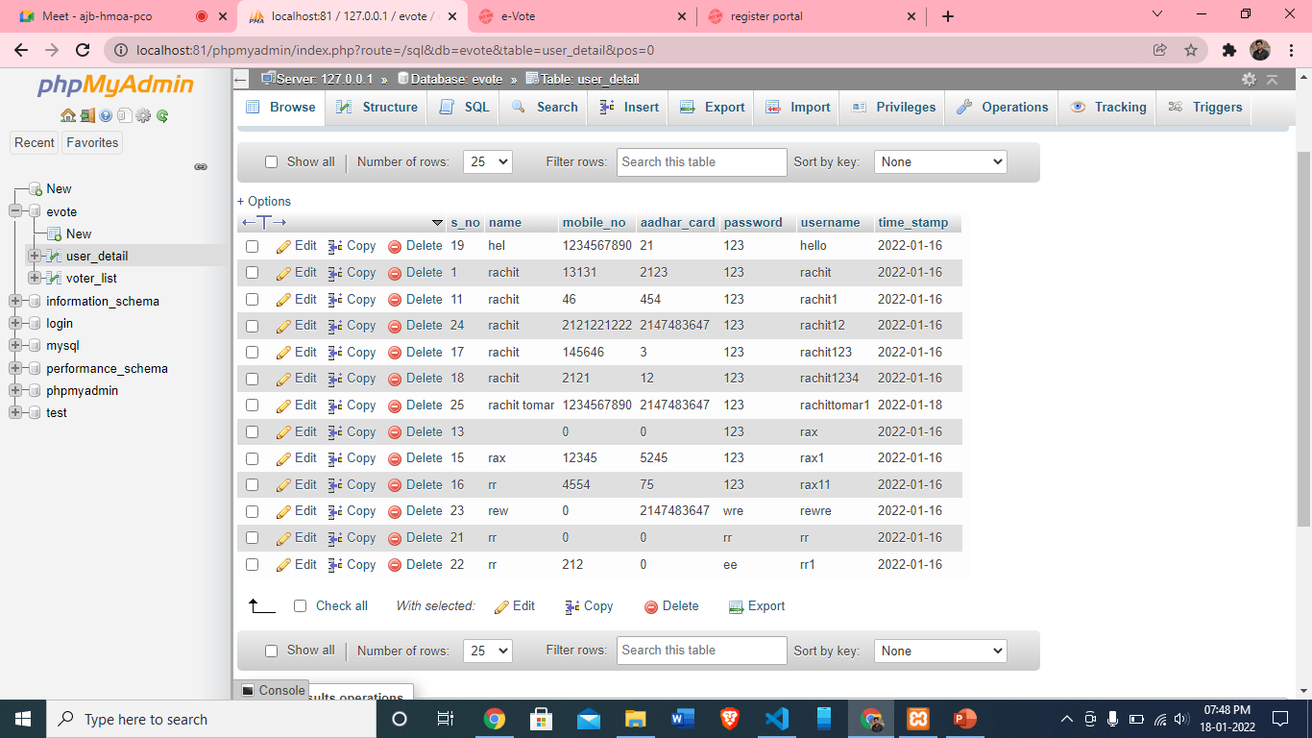
USER_DETAIL

Slide 17
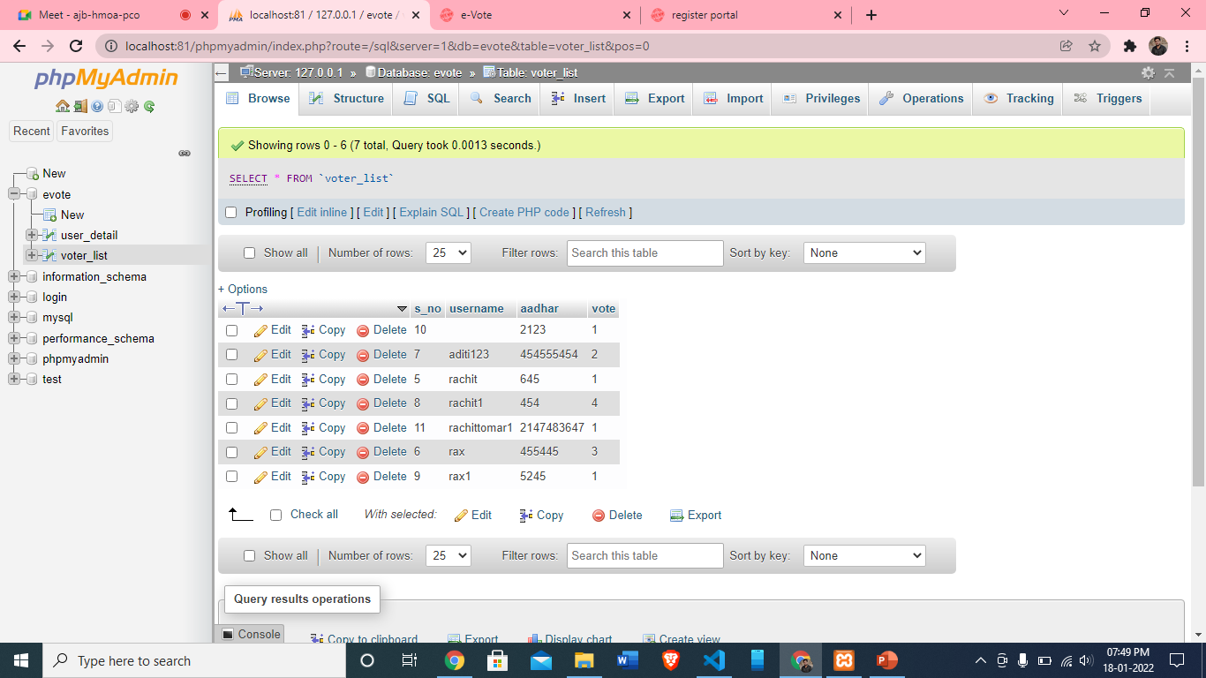
VOTER_DETAIL

Slide 18
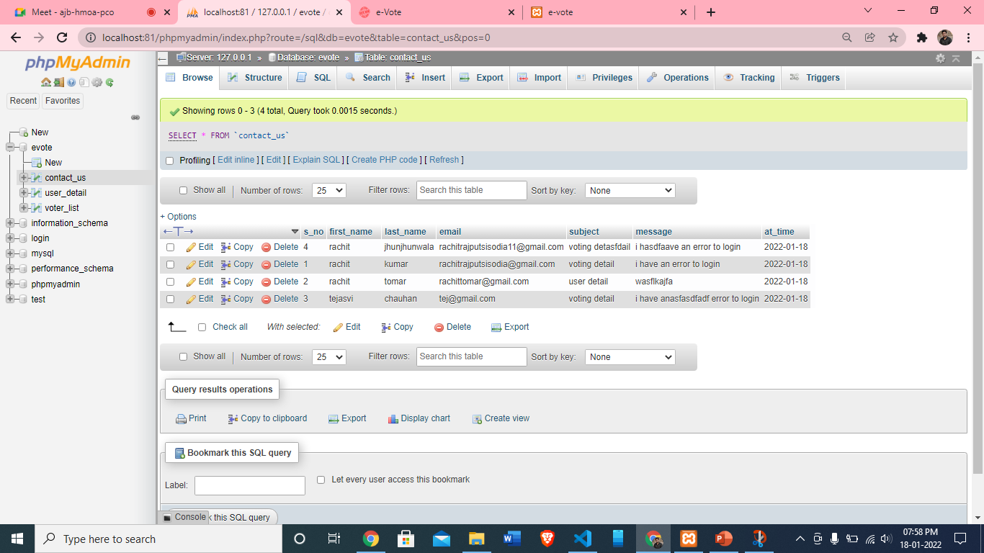
CONTACT DETAIL

Slide 19
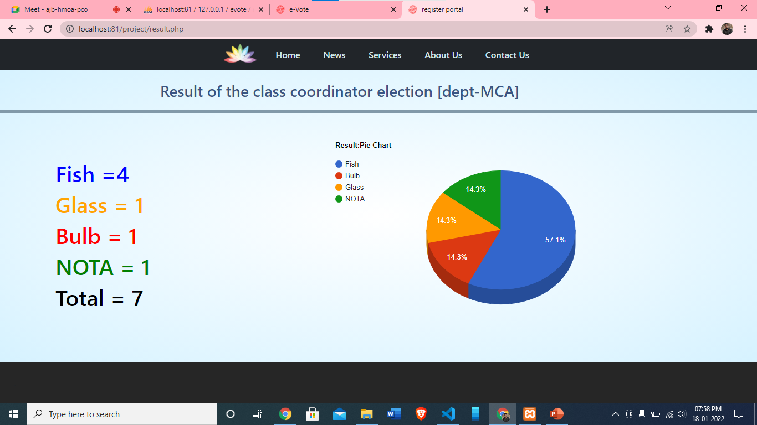
RESULT

Slide 20
ADVANTAGES
Voter can cast their vote from their home
Election result in very less time
Reduce the cost of printing ballot paper.
Secure login and registration
Easy to access

Slide 21
Hardware And Software Requirements
Software Requirements
Front End: HTML5, CSS3,JavaScript
Back End: PHP, MYSQL
Hardware Requirements
512 MB Ram
1 GB space free on hard disk drive
Good internet connectivity

Slide 22
References
Wikipedia
Youtube
Website: w3school,javatpoint etc.

Slide 23
Thank You

